Slide 1
Platform Perils
A 2D platformer built on the
Chipmunk2D physics libraries

Slide 2
Outline
Introduction
Purpose
Scope
Background
Game Demonstration
Overview of Features
Feature Showcase
OS Independent Installer
Design
Level Script Parser
Testing
Conclusion

Slide 3
Purpose
To develop a “model” game for teaching purposes
The game

Slide 4
Scope
The
Original scope t
Revised scope: to create a platformer game consisting of 3 levels

Slide 5
Background
The Chipmunk2D physics library
This library has been used in many
The benefits of

Slide 6
Demonstration

Slide 7
Overview of Features
Design Features:
Modular design facilitates

Slide 8
Feature Showcase #1: OS Independent Installer
The ability to run on all platforms was an important requirement:
CS and SFWR ENG students use

Slide 9
Feature Showcase #1: OS Independent Installer
Challenge: Our implementation uses 5 external libraries
Chipmunk2D: physics engine
GLEW: graphics extension enablement
GLFW: window manager
OpenALSoft: audio library
FreeALUT: audio utility toolkit

Slide 10
Feature Showcase #1: OS Independent Installer
Solution: cmake (www.cmake.org)

Slide 11
Feature Showcase #1: OS Independent Installer
CMake in a nutshell:
1. A script file
2. CMake reads the script

Slide 12
Feature Showcase #1: OS Independent Installer
A CMake script was written for our game:
Checks for

Slide 13
Feature Showcase #1: OS Independent Installer
Separate CMake scripts are used to build all required libraries (one for each library)
Some libraries
Many modifications were made to the to ensure compatibility (or at least reduce the chances of incompatibility!)

Slide 14
Feature Showcase #2: Building-Block Object Design
Object implementation was carried out using multiple levels of inheritance to produce a wide variety of objects with different behaviours that could all be processed in the same way via polymorphism

Slide 15
Feature Showcase #2: Building-Block Object Design
Obj
The Obj class is the top level class of the object class hierarchy
All objects inherit from this class
Contains general purpose fields that are required by all objects, mostly related to data for the GPU (meshes, textures, shaders)
Provides a common render function used by all object classes

Slide 16
Feature Showcase #2: Building-Block Object Design
Obj
PhysicsObject
The PhysicsObject class is the base class for all objects that are subject to physics calculations
Adds variables used by the Chipmunk2D physics engine to the Obj class

Slide 17
Feature Showcase #2: Building-Block Object Design
Obj
PhysicsObject
DynamicObject
DynamicObject: dynamic objects are objects on which both kinetic physics calculations as well as collision detection calculations are performed
The movement of these objects is entirely handled by the Chipmunk2D physics engine

Slide 18
Feature Showcase #2: Building-Block Object Design
Obj
PhysicsObject
DynamicObject
DynamicObject: dynamic objects are objects on which both kinetic physics calculations as well as collision detection calculations are performed
The movement of these objects is entirely handled by the Chipmunk2D physics engine

Slide 19
Feature Showcase #2: Building-Block Design
Obj
PhysicsObject
StandardObject
DynamicObject
KinematicObject
StaticObject

Slide 20
Feature Showcase #2: Building-Block Design
Obj
PhysicsObject
StandardObject
DynamicObject
KinematicObject
StaticObject

Slide 21
Feature Showcase #2: Building-Block Design
End result:
List of Kinetic Objects
List of other Physics Objects (dynamic + static)
List of Standard Objects
BEGIN FRAME
Call physics update function – performs physics calculation through timestep on all physics objects
Call update on list of kinetic objects
Call render on all objects
END FRAME

Slide 23
Feature Showcase #3: Level Scripts
From our Lego-like implementation of objects, we end up with
All objects have constructors of the form:
Object( float pos_x, float pos_y )
Some objects have a couple of additional constructor arguments, but
This allowed us to easily create a level script parser that loads levels at runtime

Slide 24
Feature Showcase #3: Level Scripts
The level script format was designed to have a straight forward syntax such that levels could easily be created by anyone
Consists of sections of object type groupings where

Slide 25
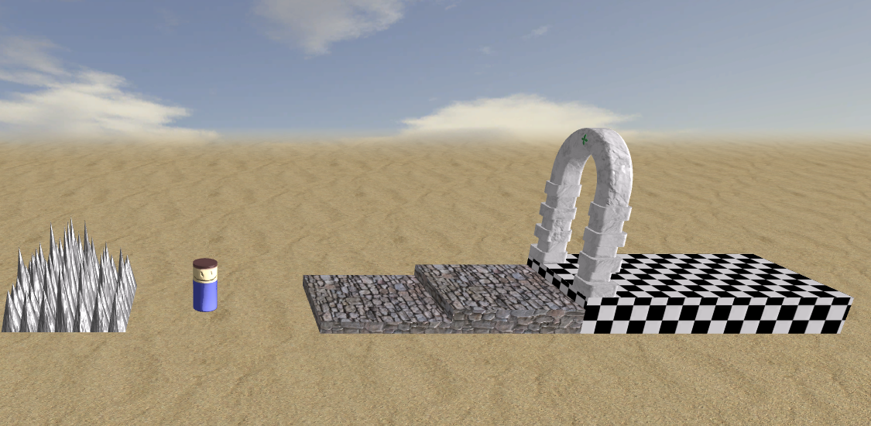
Feature Showcase #3: Level Scripts
**stage**
background=bluesky
setting=desert
startx=0
starty=0
**goal**
x=30 to 50, ytop=3, thickness=3
archpos=left
**platforms**
x=10 to 20, ytop=1
x=20 to 30, ytop=2, thickness=2
**hazards**
spikes, xright=-5, ybot=0

Slide 26
Product Testing
Automated unit testing:
A unit testing suite was developed to ensure that the physics calculations/collision detection was working correctly
This suite include

Slide 27
Conclusion

